Slide 1

Reporting and Analyzing Long-Term Assets
8
Chapter
UAA – ACCT 201 Principles of Financial Accounting Dr. Fred Barbee

Slide 2
Day #2
IS FUN!
ACCOUNTING
ACCT 201 ACCT 201 ACCT 201

Slide 3
Chapter 8 - Day 2 - Agenda
Topic | LO | Read | HW
Revenue & Capital Expenditures | P3 | 343-344 | E0, E10
Disposal of Plant Assets | P4 | 345-348 | E12, 13
Natural Resources | P5 | 348-349 | E14
Intangible Assets | P6 | 349-353 | E15, 16
Cash Flow Impact of Long-Term Assets | C4 | 353 | E17
Decision Analysis | A2 | 354 | E18
HW #7: P8-2A Due Today

Slide 4
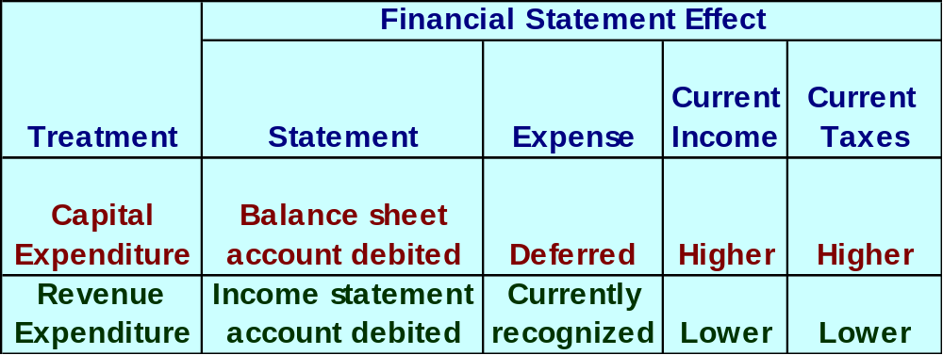
Revenue and Capital Expenditures
If the amounts involved are not material, most companies expense the item.

Slide 5
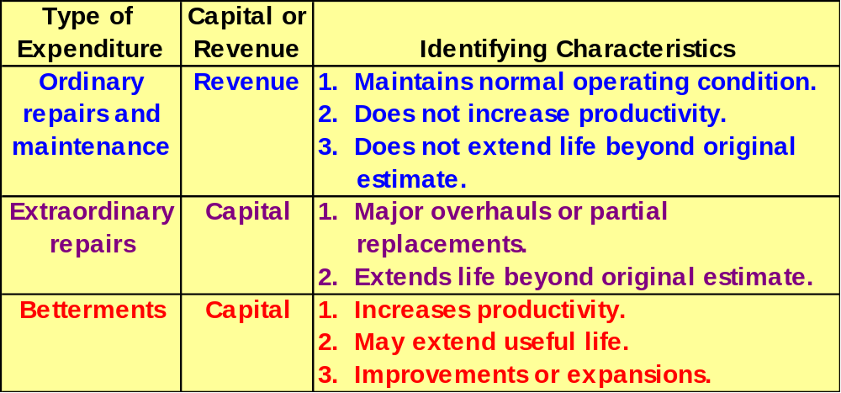
Revenue and Capital Expenditures

Slide 6
Discarding Plant Assets
Update depreciation
to the date of disposal.
Journalize disposal by:
Recording cash
received (debit)
or paid (credit).
Recording a
gain (credit)
or loss (debit).
Removing accumulated
depreciation (debit).
Removing the
asset cost (credit).

Slide 7
Discarding Plant Assets
If Cash > BV, record a gain (credit).
If Cash < BV, record a loss (debit).
If Cash = BV, no gain or loss.
Update depreciation
to the date of disposal.
Journalize disposal by:
Recording cash
received (debit)
or paid (credit).
Recording a
gain (credit)
or loss (debit).
Removing accumulated
depreciation (debit).
Removing the
asset cost (credit).

Slide 8
Selling Plant Assets
On September 30, 2001, Evans Company sells a machine that originally cost $100,000 for $58,000 cash. The machine was placed in service on January 1, 1996. It was depreciated using the straight-line method with an estimated salvage value of $20,000 and a useful life of 10 years.
Let’s answer the following questions.

Slide 9
Selling Plant Assets
The amount of depreciation recorded on September 30, 2001,
to bring depreciation up to date is:
a. $8,000.
b. $6,000.
c. $4,000.
d. $2,000.
Annual Depreciation:
($100,000 - $20,000) ÷ 10 Yrs. = $8,000
Depreciation to Sept. 30:
9/12 × $8,000 = $6,000

Slide 10
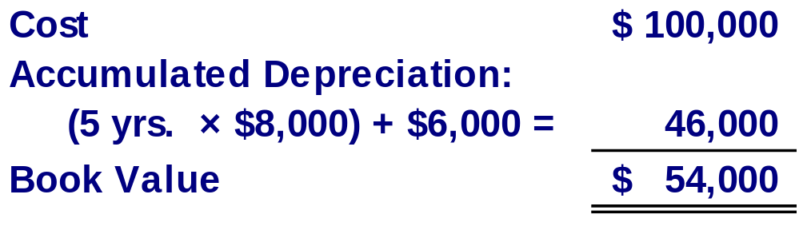
Selling Plant Assets
After updating the depreciation, the machine’s book value on September 30, 2001, is:
a. $54,000.
b. $46,000.
c. $40,000.
d. $60,000.

Slide 11
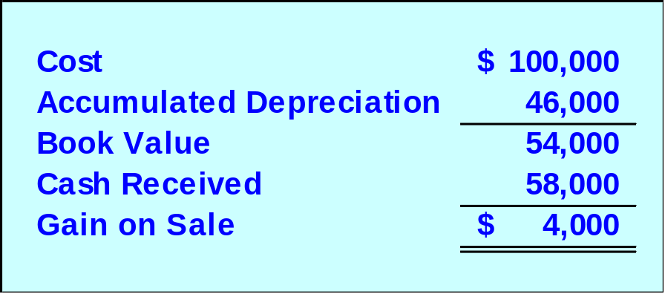
Selling Plant Assets
The machine’s sale resulted in:
a. a gain of $6,000.
b. a gain of $4,000.
c. a loss of $6,000.
d. a loss of $4,000.
Now, you are ready to prepare the journal entry to record the sale of the asset.

Slide 12
Selling Plant Assets
GENERAL JOURNAL
Page
25
Post.
Date
Description
Ref.
Debit
Credit
Sept
30
Cash
58,000
Accumulated Depreciation
46,000
Gain on Sale
4,000
Machine
100,000
ACCT 201 ACCT 201 ACCT 201

Slide 13


Exchanging Plant Assets
SIMILAR
Accounting for exchanges of similar assets depends on whether the book value of the asset(s) given up is less or more than the market value of the asset(s) received.
ACCT 201 ACCT 201 ACCT 201

Slide 14
Exchanging Plant Assets
SIMILAR
Gain
A loss is recognized when the book value given up is more than the market value received.
A gain is not recognized when the book value given up is less than the market value received.
Loss
ACCT 201 ACCT 201 ACCT 201

Slide 15
Exchanging Plant Assets
SIMILAR
On May 30, 2001, Essex Company exchanged a used airplane and $35,000 cash for a new airplane. The old airplane originally cost $40,000, had up-to-date accumulated depreciation of $30,000, and a fair value of $4,000.
ACCT 201 ACCT 201 ACCT 201

Slide 16
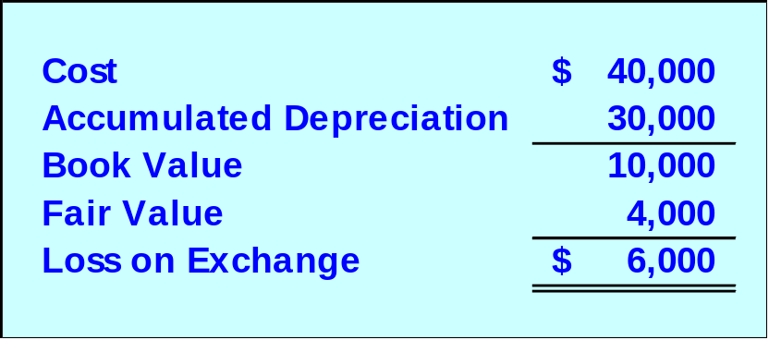
Exchanging Plant Assets
The exchange resulted in a:
a. gain of $6,000.
b. loss of $6,000.
c. loss of $4,000.
d. gain of $4,000.
Let’s prepare the journal entry.
ACCT 201 ACCT 201 ACCT 201

Slide 17
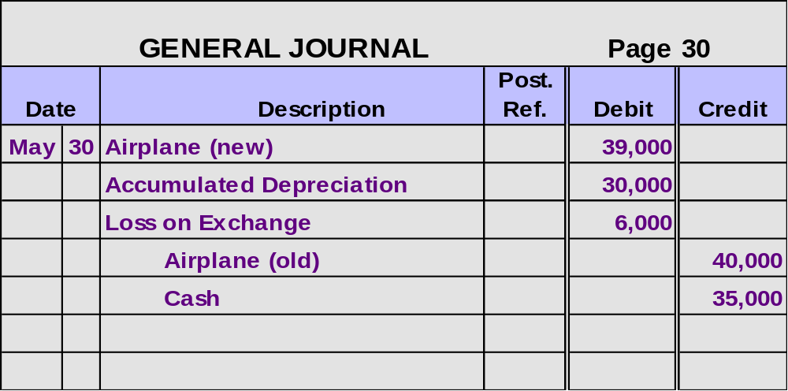
Exchanging Plant Assets
Remember that losses are always recorded immediately.
ACCT 201 ACCT 201 ACCT 201

Slide 18
Exchanging Plant Assets
On May 30, 2001, Essex Company exchanged a used airplane and $35,000 cash for a new airplane. The old airplane originally cost $40,000, had up-to-date accumulated depreciation of $30,000, and a fair value of $14,000.
SIMILAR
ACCT 201 ACCT 201 ACCT 201

Slide 19
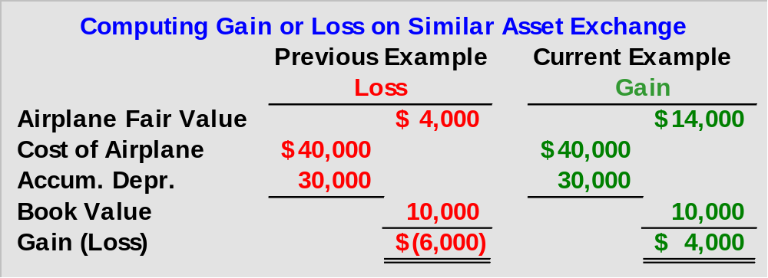
Exchanging Plant Assets
The $4,000 gain is not recognized.
ACCT 201 ACCT 201 ACCT 201

Slide 20
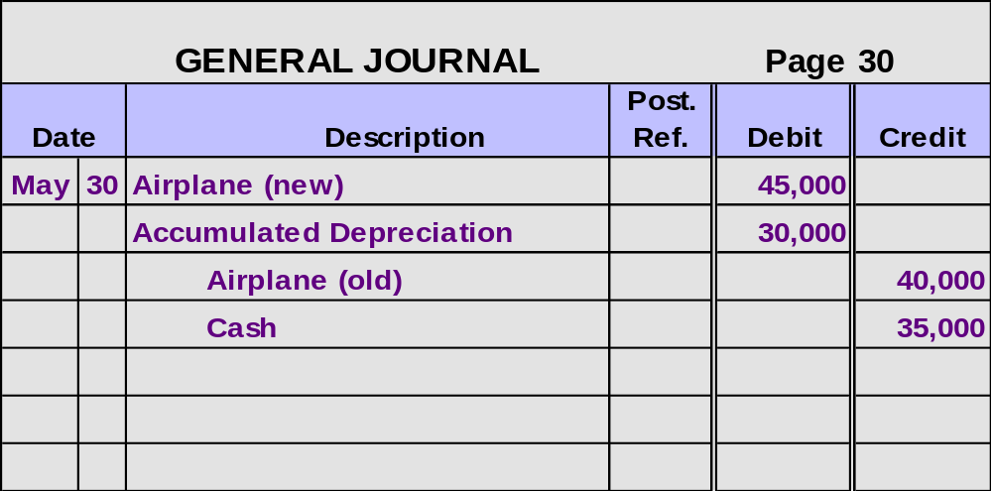
Exchanging Plant Assets
Book value of old asset + cash paid
$10,000 + $35,000 = $45,000
ACCT 201 ACCT 201 ACCT 201

Slide 21

ACCT 201 ACCT 201 ACCT 201
Let’s Change the Subject!
ACCT 201 ACCT 201 ACCT 201

Slide 22

Natural Resources
Total cost,
including
exploration and
development,
is charged to
depletion expense
over periods
benefited.
Extracted from
the natural
environment
and reported
at cost less
accumulated
depletion.
Examples: oil, coal, gold

Slide 23
Depletion of Natural Resources
Depletion is calculated using the
units-of-production method.
Unit depletion rate is calculated as follows:
Cost – Salvage Value
Total Units of Capacity

Slide 24
Depletion of Natural Resources
Total depletion cost for a period is:
Unit Depletion
×
Number of Units
Rate
Extracted in Period
Cost of
goods sold
Total
depletion
cost
Inventory
for sale
Unsold
Inventory
ACCT 201 ACCT 201 ACCT 201

Slide 25
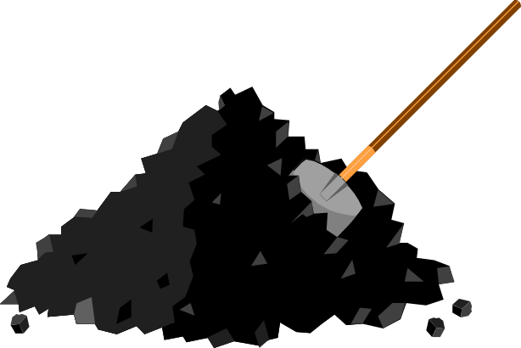
Depletion of Natural Resources
ABC Mining acquired a tract of land containing ore deposits.
Total costs of acquisition and development were $1,000,000 and ABC estimated the land contained 40,000 tons of ore.

Slide 26
Depletion of Natural Resources
What is ABC’s depletion rate?
a. $40 per ton
b. $50 per ton
c. $25 per ton
d. $20 per ton
Cost ÷ Units
$1,000,000 ÷ 40,000 Tons
= $25 Per Ton
ACCT 201 ACCT 201 ACCT 201

Slide 27
Depletion of Natural Resources
For the year ABC mined and sold 13,000 tons. What is the total depletion cost for the year?
a. $300,000
b. $325,000
c. $225,000
d. $275,000
Depletion cost = 13,000 x $25
= $325,000
ACCT 201 ACCT 201 ACCT 201

Slide 28
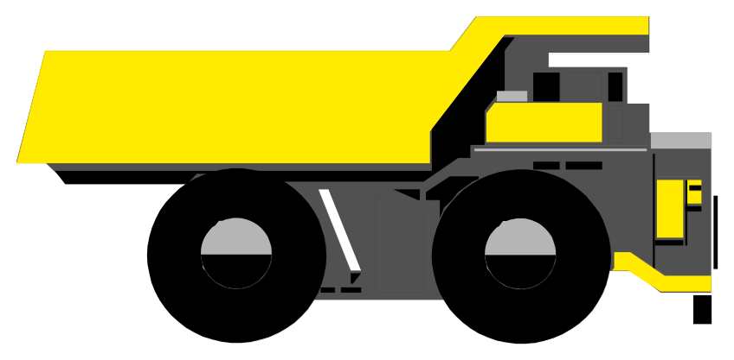
Plant Assets Used in Extracting Natural Resources
Specialized plant assets may be required to extract the natural resource.
These assets are recorded in a separate account and depreciated.

Slide 29
ACCT 201 ACCT 201 ACCT 201
Let’s Change the Subject!
(again!)
ACCT 201 ACCT 201 ACCT 201

Slide 30
Intangible Assets
Noncurrent assets
without physical
substance.
Often provide
exclusive rights
or privileges.
Intangible
Assets
Useful life is
often difficult
to determine.
Usually acquired
for operational
use.
ACCT 201 ACCT 201 ACCT 201

Slide 31


Accounting For Intangible Assets
Record at current cash equivalent cost, including purchase price, legal fees, and filing fees.
Patents
Copyrights
Leaseholds
Leasehold
Improvements
Franchises and Licenses
Goodwill
Trademarks and
Trade Names
ACCT 201 ACCT 201 ACCT 201

Slide 32

Accounting for Intangible Assets
Usually amortized over shorter of economic life or legal life.
Use straight-line method.
Research and development costs are normally expensed as incurred.

Slide 33
Accounting For Goodwill
Goodwill
Occurs when one
company buys
another company.
Only purchased
goodwill is an
intangible asset.
The amount by which the
purchase price exceeds the fair
market value of net assets acquired.

Slide 34
Goodwill
Eddy Company paid $1,000,000 to purchase all of James Company’s assets and assumed liabilities of $200,000.
The acquired assets were appraised at a fair value of $900,000.

Slide 35
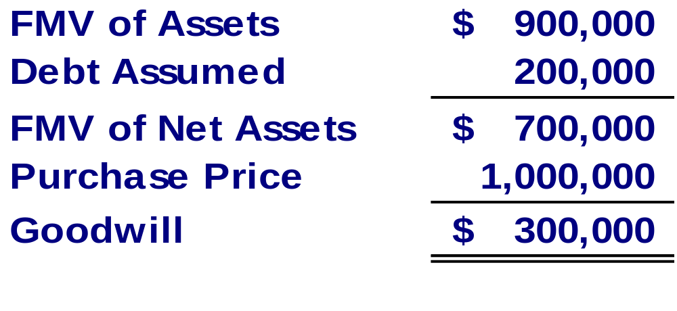
Accounting For Goodwill
What amount of goodwill should be recorded on Eddy Company books?
a. $100,000
b. $200,000
c. $300,000
d. $400,000
ACCT 201 ACCT 201 ACCT 201

Slide 36

Cash Flow Impacts of
Long-Term Assets
Investing Cash Inflow: Sale of Long-Term Assets
Investing Cash Outflow: Purchase of Long-Term Assets.

Slide 37
Total Asset Turnover
Total Asset
Turnover
Net Sales
Average Total Assets
=
Provides information about a company’s
efficiency in using its assets.
ACCT 201 ACCT 201 ACCT 201

